Slide 1

CAPSTONE PROJECT Inventory Optimization for Retail Using Predictive Analytics
PRESENTED BY
STUDENT NAME: Bharath Linga Reddy Palem
COLLEGE NAME: ICFAI FOUNDATION FOR HIGHER EDUCATION
DEPARTMENT:CSE(DS&AI)
EMAIL ID: palembharath064@gmail.com
AICTE STUDENT ID: STU664214004feec1715606528

Slide 2
OUTLINE
Problem Statement (Should not include solution)
Proposed System/Solution
System Development Approach (Technology Used)
Algorithm & Deployment
Result (Output Image)
Conclusion
Future Scope
References

Slide 3
PROBLEM STATEMENT
Retailers frequently face the issue of maintaining the right inventory levels across multiple products and stores. Overstocking leads to high holding costs and wastage, while understocking results in lost sales and customer dissatisfaction. Without accurate demand forecasting, making informed inventory decisions becomes challenging.

Slide 4
PROPOSED SOLUTION
Objective:
To develop a predictive system that forecasts product demand and recommends optimal inventory levels, minimizing overstock and stockouts.
Solution Components:
1. Data Collection:
- Gather historical sales data per product and store.
- Incorporate additional contextual data (e.g., date, promotions, seasonality).
2. Data Preprocessing:
- Clean missing or inconsistent entries.
- Perform feature engineering (e.g., extract day of week, trends, lags).
3. Machine Learning Model:
- Apply supervised learning algorithms like Random Forest for regression.
- Predict demand quantities for each product-store combination.
4. Forecast & Optimization:
- Forecast product demand for upcoming periods.
- Recommend optimal inventory levels based on predicted sales and safety stock logic.
5. Evaluation:
- Measure model performance using metrics such as MAE, RMSE, and R² score.
- Identify and address high-error cases and underperforming segments.
6. Output & Reporting:
- Generate HTML reports with model results and visualizations.
- Enable export of predictions for integration with ERP/inventory systems.

Slide 5
SYSTEM APPROACH
Technologies Used:
- Programming Language: Python 3.9+
- Development Tools: Jupyter Notebook, Git, VS Code
Libraries & Frameworks:
- Data Handling: pandas, numpy
- Machine Learning: scikit-learn
- Visualization: matplotlib, seaborn
System Requirements:
- Minimum 4 GB RAM
- Python environment with required packages
Code Structure:
- Modular scripts for data preprocessing, model training, evaluation, and reporting

Slide 6
ALGORITHM & DEPLOYMENT
Algorithm Used:
- Random Forest Regressor from scikit-learn
- Chosen for its robustness and ability to handle nonlinear tabular data
Input Features:
- Historical sales data
- Date-related features (day, month, weekday)
- Product/store IDs, past demand values
Training Process:
- Train-test split applied
- Model trained on engineered features
- Performance measured using MAE, RMSE, and R² Score
Prediction & Deployment:
- Predicts weekly demand per product-store pair
- Generates inventory recommendations with safety stock
- Results compiled in HTML reports for analysis

Slide 7
RESULT
Model Performance (Product P001, Store S01):
- MAE: 19.19 → Average error of 19 units per prediction
- RMSE: 20.63 → Presence of larger prediction errors
- R² Score: -0.0185 → Model underperforms against mean prediction
- MAPE: 97.59% → High relative error, nearly 98%
Analysis:
- Model fails to capture sales trend effectively
- Large variance and limited features may impact performance
Forecast Output (Next 4 Weeks):
- Predicted sales: 29.62 to 36.21 units
- Suggested inventory: 49 to 59 units
Visual (to include on slide):
- Line chart comparing actual vs. predicted sales
- Bar chart showing weekly forecast with inventory recommendations

Slide 8
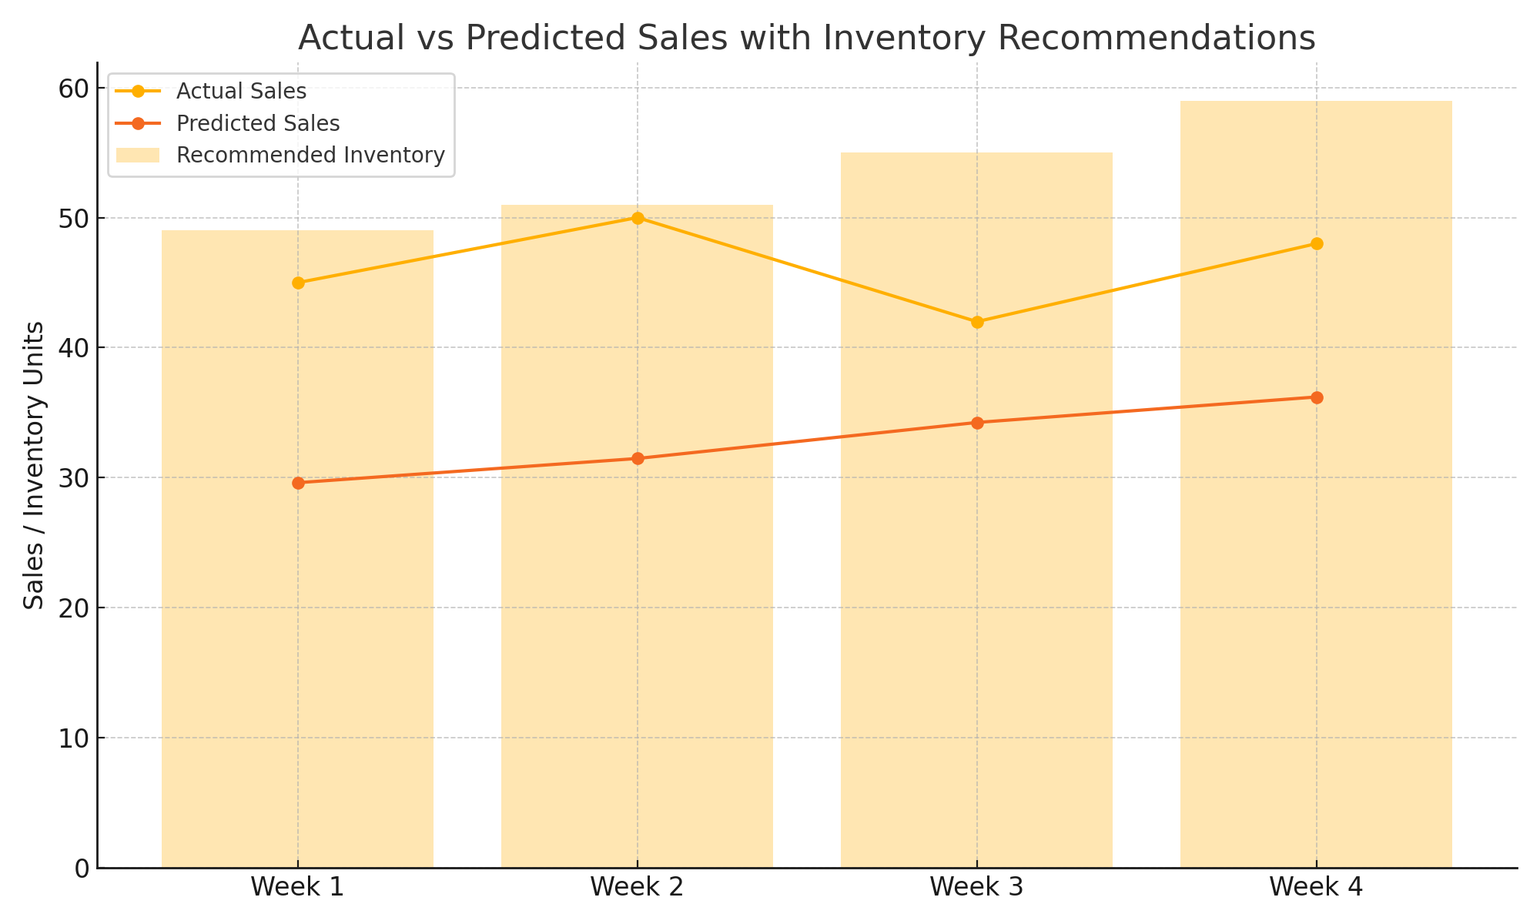

Slide 9
CONCLUSION
- A Random Forest model was built to predict weekly product demand.
- Results showed limited accuracy (MAE: 19.19, MAPE: 97.59%), indicating room for improvement.
- Key challenges: high data variability, limited features, lack of external factors.
- Improvements: add promotional/seasonal data, try advanced models (e.g., XGBoost).
- Accurate forecasts help reduce stockouts and improve inventory planning in retail.

Slide 10
FUTURE SCOPE
- Integrate external data (e.g., promotions, holidays, weather) for richer context.
- Apply advanced models like XGBoost, LSTM, or ensemble methods for better accuracy.
- Expand system to support multiple products, stores, and regions.
- Implement real-time forecasting using APIs or edge computing devices.
- Explore automated inventory adjustments based on continuous demand tracking.

Slide 11
REFERENCES
Key References on Forecasting & Machine Learning in Supply Chains
Hyndman & Athanasopoulos (2018) Forecasting: Principles and Practice
Overview of forecasting techniques, from statistical to machine learning methods.
Silver, Pyke & Thomas (2016) Inventory and Production Management in Supply Chains
Focuses on inventory control, production scheduling, and supply chain management strategies.
Carbonneau et al. (2008) Application of Machine Learning Techniques for Supply Chain Demand Forecasting
Explores machine learning methods to improve demand forecasting accuracy.
Makridakis et al. (2018) Statistical and Machine Learning Forecasting Methods
Compares forecasting methods, analyzing their performance in different contexts.
GitHub Link: https://github.com/BharathLingaReddy-Palem/retail-demand-forecasting

Slide 12
Thank you

